Slide 1


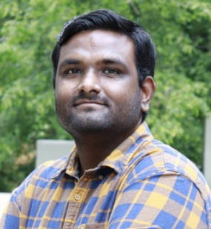

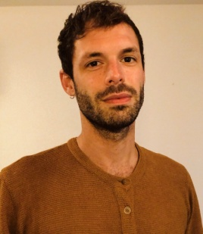




Exploratory attentional resource allocation by the anterior prefrontal cortex (C02)
Parthiban Saravanakumar
PI: Prof. Dr. Max Happel
Lasse Gueldener
PI: Prof. Dr. Stefan Pollmann
Funded by the Deutsche Forschungsgemeinschaft (DFG, German Research Foundation) – Project-ID 425899996
Notes:
Hello everyone I report today on the progress of our Project C02 in which we study the role of the FPC during exploratory shifts of attention comparatively in humans and gerblis.

Slide 2
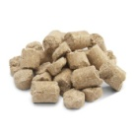
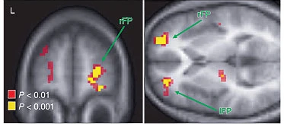
C02 – Happel/Pollmann
BACKGROUND
Should I Stay Or Should I Go?
The anterior prefrontal cortex (aPFC) is regarded as a decisive part of a neurocognitive circuit for the neuronal realization of exploratory resource allocation in human and non-human primates (Daw et al., 2006; Mansouri et al., 2015)
Exploitation
Exploration
RESEARCH QUESTIONS
How can the exploratory resource allocation be investigated ?
How is exploratory resource allocation achieved on the meso-scale and macro-scale levels?
Frontopolar activation due to exploration in gambling task
Daw et al., 2006
Funded by the Deutsche Forschungsgemeinschaft (DFG, German Research Foundation) – Project-ID 425899996
Notes:
When we picture this gerbils here roaming in ita natural habitat, is constantly confronted with the decions to either keep exploiting a current food source that will depleat over time or to explore the environment and search for a new potentially better food source taking the riks that there will be none
From studies in humans primates we know that FPC takes a central role in the exploratory redistribution of cogntive recources and we aimed firstly to develope task conditons that allow to study the exploration exploitation dilemma during foraging comparatively between the two species and we aimed to invetsigate the role of FPC at the macro scale using fMRI in humans and at the meso scale in gerbils using current source density measures
2

Slide 3
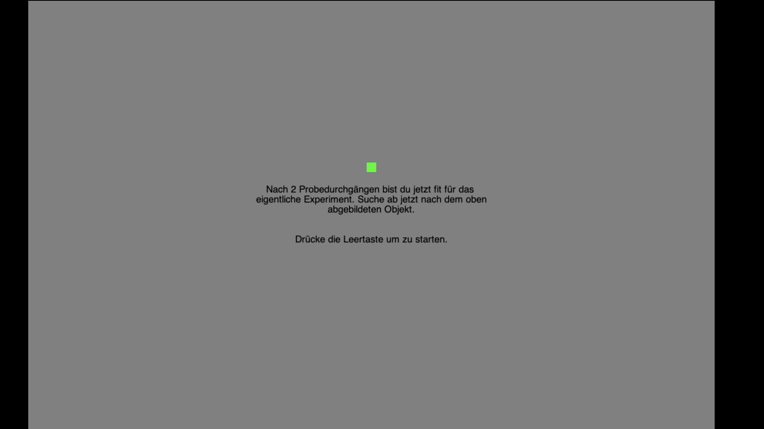
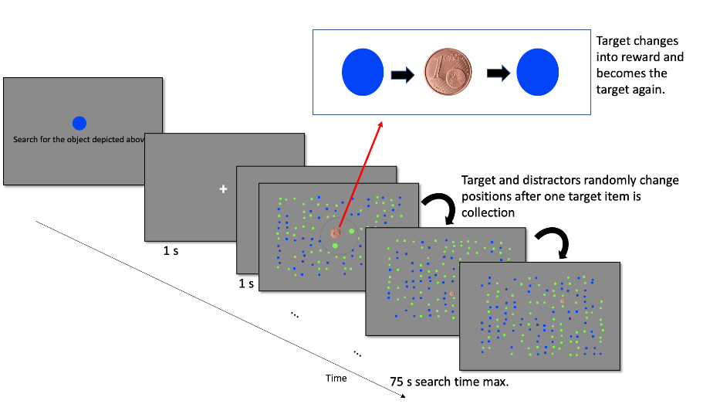
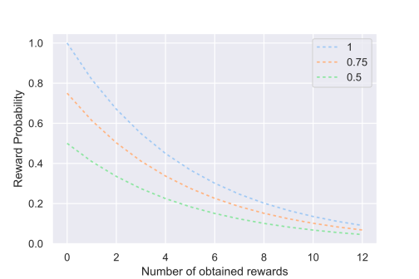
C02 – Happel/Pollmann
HUMAN FORAGING TASK
Goal:
Paradigm should faciliate self-initated “patch-leaving“ behavior, i.e., the self-initiated switch to a new search display
Foraging task
Pilot sessions, n=20
2 trails of training, 6x10 minutes search time in the main experiment
Funded by the Deutsche Forschungsgemeinschaft (DFG, German Research Foundation) – Project-ID 425899996
Notes:
As you can see in this video, human performed a simple visual search task. For searching within the display, the subjects used an MR compatible PC mouse. If the mouse point hits a target, it will briefly turn into a reward indicator which then returns to its previous appearance. Already detected targets remain unrewarded. To further imitate a depleting food source, additional number of targets are deactivated following an exponential decay function. So the reward probability within a given display drops constantly with each earning and to compensate for this, participants can choose to end the search in a display and to proceed to a new display of unknown quality by button press at any time. exactly these self-initiated switches between display we considered as the patch-leaving behavior requiring exploratory decision making which we were interested in.
3

Slide 4
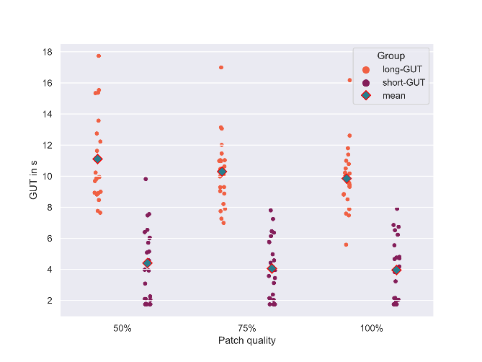
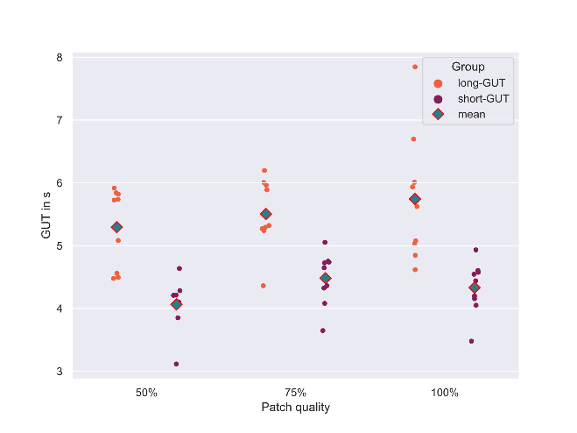
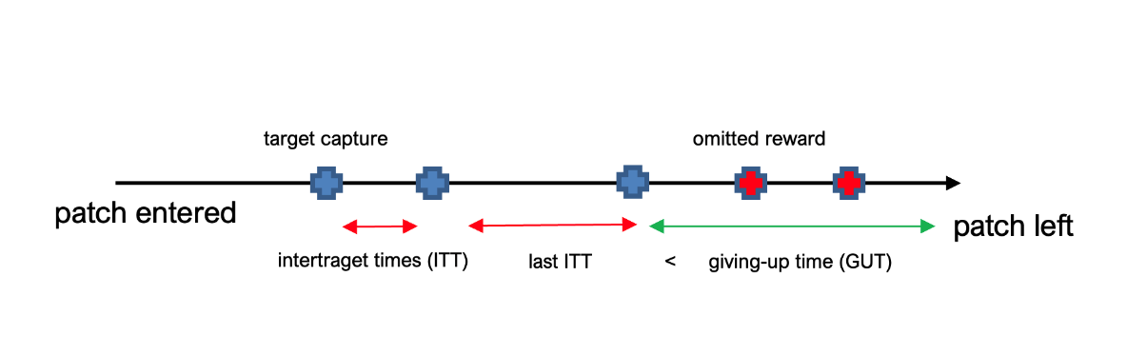
C02 – Happel/Pollmann
PREVIOUS RESULTS
Mechanisms humans‘ and gerbils‘ patch-leaving decisions obey to:
1) Building subgroups based on median GUTs
Humans
Gerbils
Funded by the Deutsche Forschungsgemeinschaft (DFG, German Research Foundation) – Project-ID 425899996
Notes:
In the first part of our project we aimed to compare the mechanisms driving patch-leaving decisons between humans and gerbils
Especially humans NEXT showed a large dispersion in their Giving up times. NEXT GUT is the time subjects kept searching in the current display since the last reward capture and eventually leaving the display and can be understood as an behavioral index of exploitation. NEXT. because of this high variability in this parameter, we split the sample of humans by ist median GUT in two subgroups. NEXT For better comparison we did the same for the gerbils too.
4

Slide 5
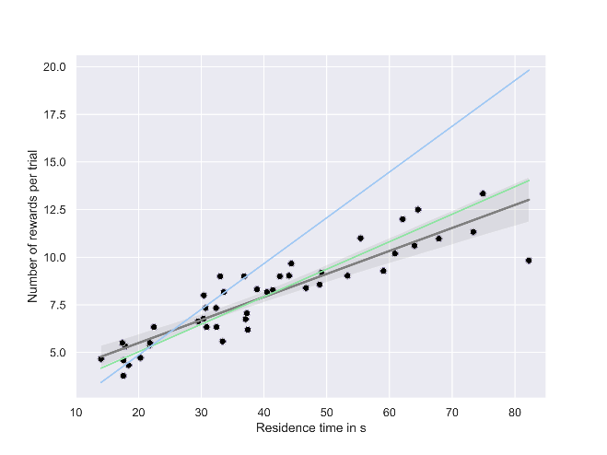
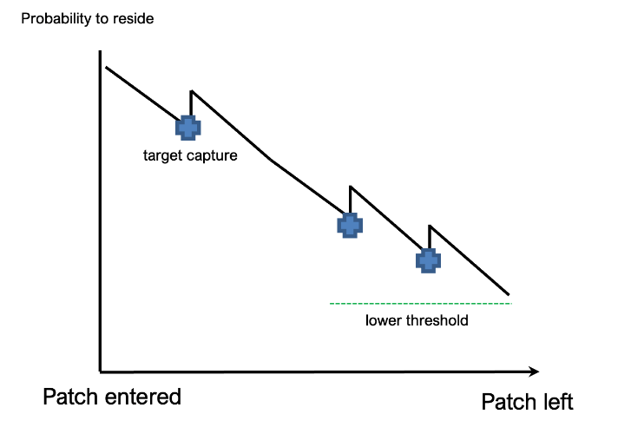
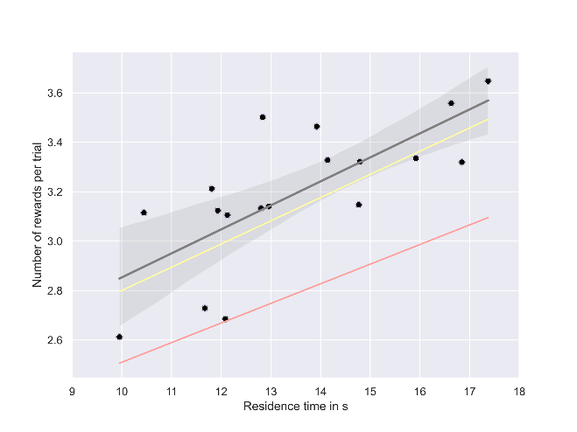
C02 – Happel/Pollmann
PREVIOUS RESULTS
Mechanisms humans‘ and gerbils‘ patch-leaving decisions obey to:
2) Incremental mechanism postpones patch-leaving in both species (see Lottem et al., 2018)
Humans
Mean slope shortGUT
Mean slope longGUT
Gerbils
Mean slope longGUT
Mean slope longGUT
Funded by the Deutsche Forschungsgemeinschaft (DFG, German Research Foundation) – Project-ID 425899996
Notes:
Both humans and gerbils NEXT postponed their patch-leaving with each new reward encounter incrementally which is consistent with the incremental rule of patch-leaving.NEXT
According to thise rule the probability to stray starts to decrease continously by entering the patch and the patch is left if it reaches a lower threshold., Now, each new reward encounter resets the probability leading to a positive relatioship between single reward encounters within a patchj and residence times.
This is just one part of the results. the whole analysis we put into a manuscript that is currently in revision at comm. biology.
5

Slide 6
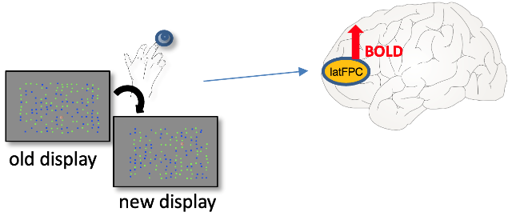
C02 – Happel/Pollmann
HYPOTHESES fMRI STUDY
1) Exploratory shifts of attention during patch-leaving supported by FPC
2) The Giving-up time (GUT):
In studies in elderly: decline in exploratory behavior (Spreng & Turner, 2021)
Prolonged GUTs as an indicator for declining exploration (Mata et al. 2009)
Improved decions making and cogntive control during gambling correlated positively
with FPC signal strength (Boormann et al., 2009, Laureiro-Martinze et al., 2015)
FPC Signal during patch-leaving in short-GUT subjects > long-GUT subjects
Funded by the Deutsche Forschungsgemeinschaft (DFG, German Research Foundation) – Project-ID 425899996
Notes:
After investigating the behavioral rule subjects use to time their patch-leaving decions, the fMRI experiment we conducted to study the role of FPC in supporting exploratory shifts of attention during patch leaving.
NEXT Firstly, we expected positive BOLD signal changes in FPC when particpants decided to switch to a new display.
NEXT In addition we also expected FPC‘s signal strength to be modulated by interinidivdual differences in subjects‘
behavioral tendencies to explore versus exploit.From studies in elderly we know that there is a decline in exploratory behavior leading to increased giving-up times during foraging and Previous neuroimaging studies could link improved decison making during foraging with increased FPC signaling during gambling.
NEXT Therefore we expected that the BOLD Signal strength in FPC during patch-leaving should be modulated by interinidivdual differences in their readiness to explore indexed by their GUTs (where we expected stronger signal changes in subjects with short GUTs;
6

Slide 7
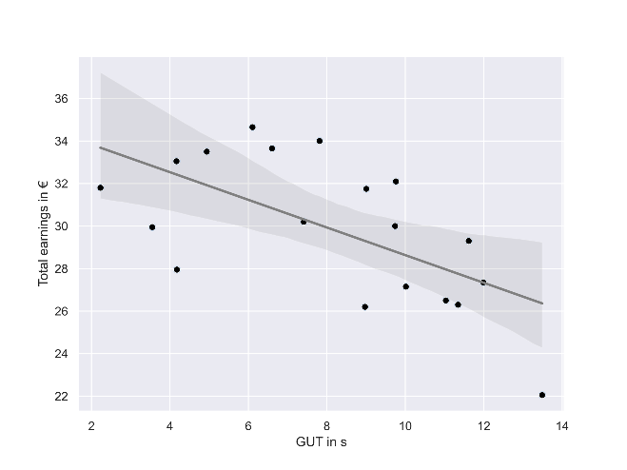
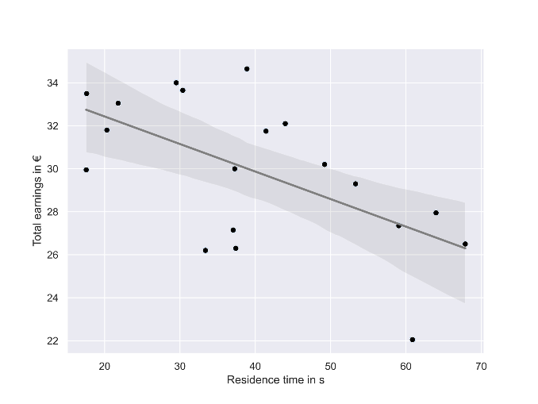
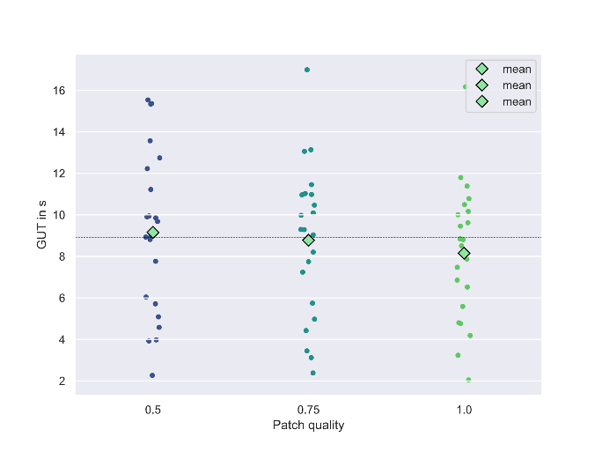

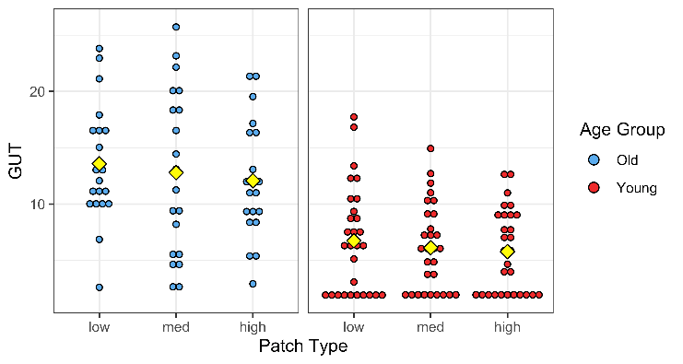
C02 – Happel/Pollmann
RESULTS
I fMRI - behavioral bias for exploitation associated with poorer task performance:
a) b) c)
r = -0.67, p = .007
r = -0.57, p = .002
long GUT
short GUT
II For comparison: foraging in elderly (n = 20):
**
Sara Classen
Funded by the Deutsche Forschungsgemeinschaft (DFG, German Research Foundation) – Project-ID 425899996
Notes:
The behavioral data of the fMRI sample showed a strong negtaive coorelation between subjects GUTs and total earnings which u see in figure a) as well as residence times and total earnings (figure b)) indicating that those subjects who employed a rather exploitative forgaing strategy made signficantly less earnings compared to subjects who explored more readily. Similiar to previous results, there was a large dispersion in the GUTs across particpants suggesting considerable variation in how readily subjects were to make patch-leaving decions.
NEXT From our sample in elderly we know that this is also true for old-age foragers. At the same time there is a large age effect with significantly longer GUTs in old compared to young people. Together this data shows that consierbale variation exists in subject‘s tendency towards exploration versus exploitation and that a bias towards exploitation impacted the foraging performance negatively.
Credits go to our student assistant Sara classen who was responsible for studying foraging in elderly.
7

Slide 8
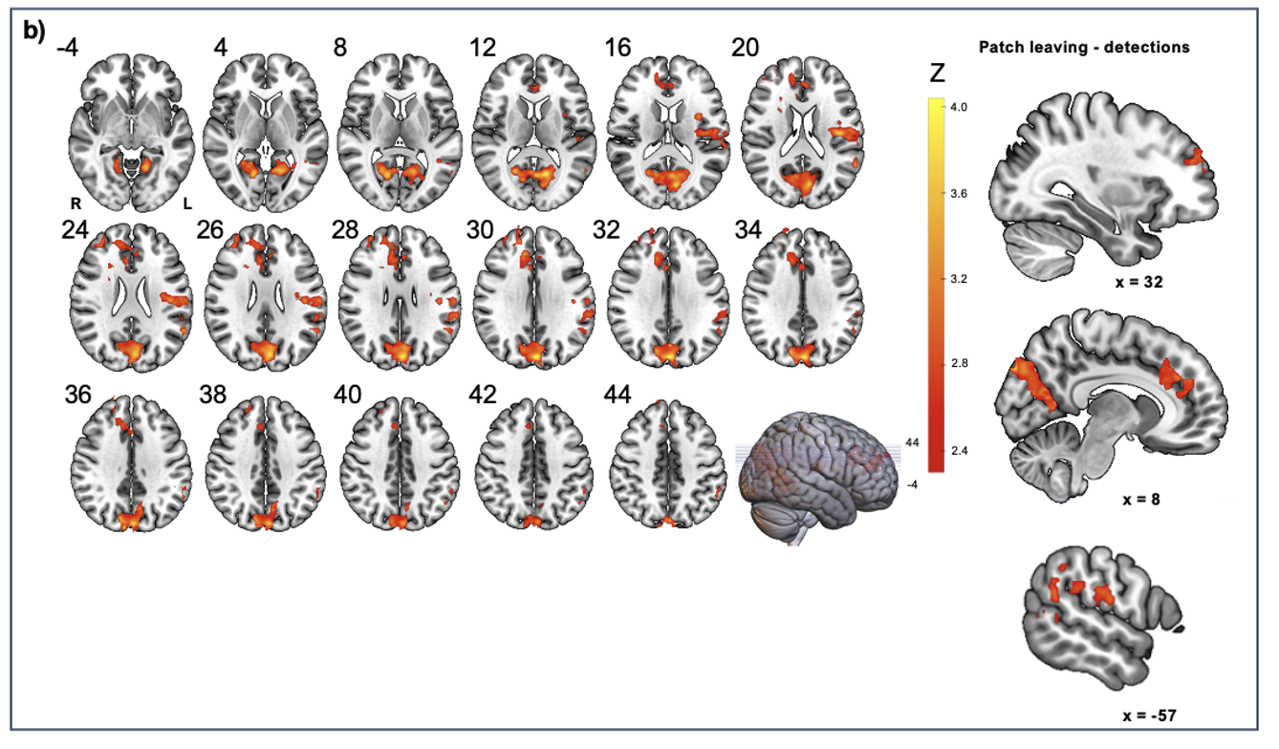
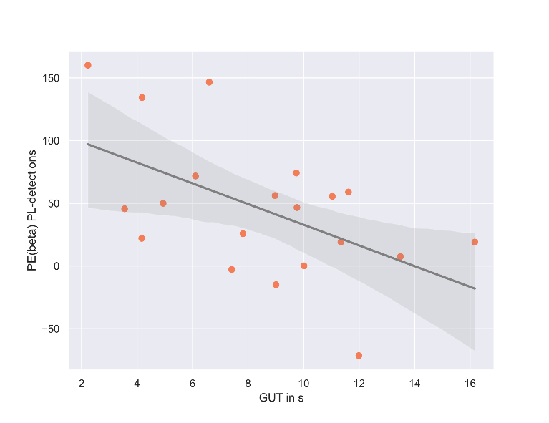
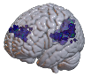
C02 – Happel/Pollmann
RESULTS fMRI
r = - 0.539, p = .007
Association between beta weights and GUTs
GLM of BOLD-signal: testing for brain regions more active during patch leaving compared to the search phase.
n = 20, z = 2.3, p_{fwe} < .01 (Gueldener and Pollmann in prep.)
Funded by the Deutsche Forschungsgemeinschaft (DFG, German Research Foundation) – Project-ID 425899996
Notes:
In the analysis of the fMRI data, we aimed to test brain regions more active during patch-leaving (i.e., when subjects decided to switch to the next display) compared search-related activity and contratested the time point of patch-leavinf against the onsets of target detection during the prior search phase. NEXT In line with our first hypothesis, we found significant activity changes related to patch-leaving decions the right lateral FPC, the anterior division of the cingulate cortex (dACC including the the rostral cingulate zone (RCZ)) and posteriorly in the angular (AG) and supramarginal gyrus comprising parts of temporo parietal junction . This confirmed our expectation that FPC together with TPJ supports exploratory shifts of attention during patch-leaving
NEXT with respect to our second hypothesis, we found a signifciant negative correlation between beta weighst extracted from the brain regions active during patch-leaving and partciapnts GUTs. So the longer the GUTs were, the smaler was the strength of the signal change in line with our prediction.
8

Slide 9
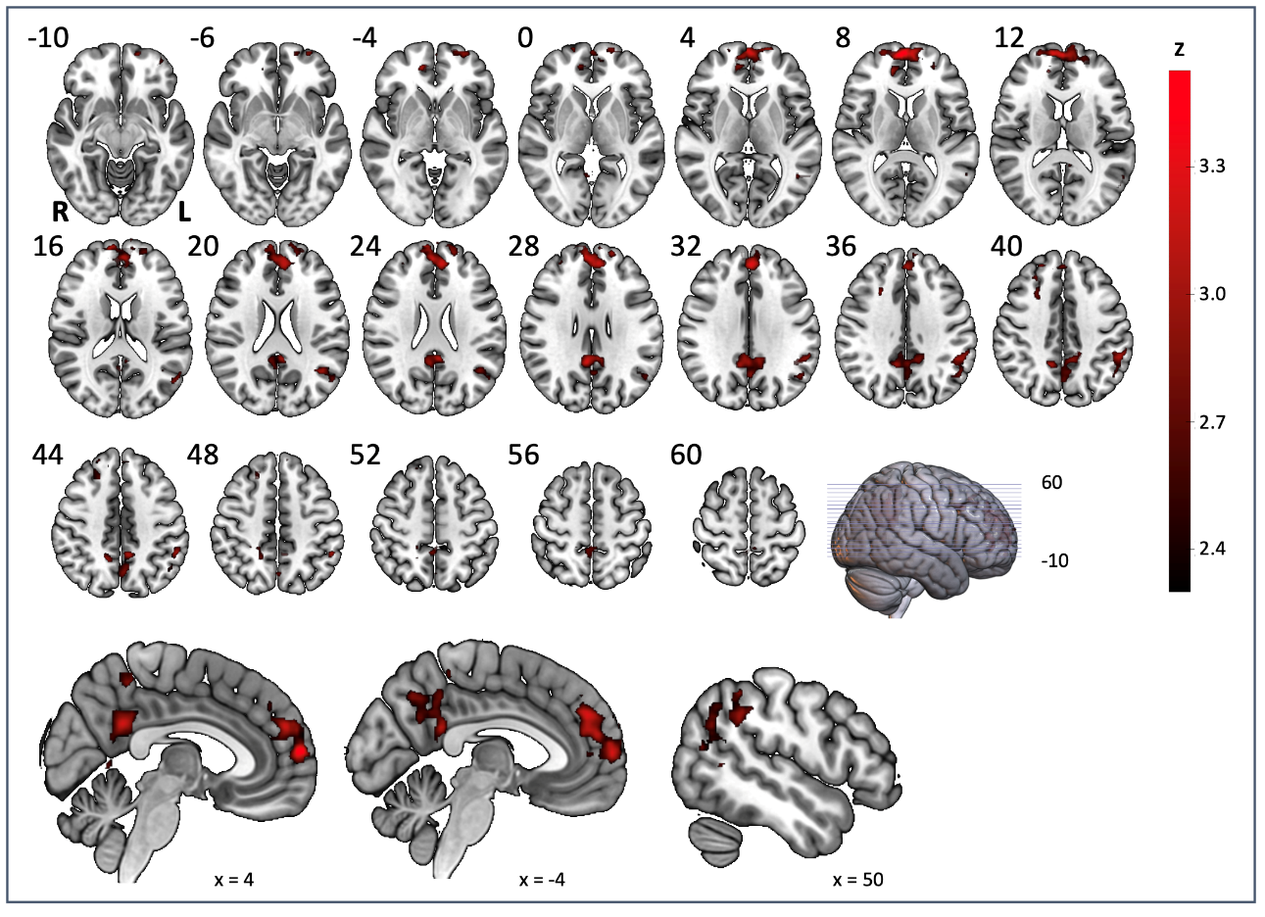
C02 – Happel/Pollmann
RESULTS fMRI
Short GUT patch leaving > long GUT patch leaving
long GUT
short GUT
Funded by the Deutsche Forschungsgemeinschaft (DFG, German Research Foundation) – Project-ID 425899996
Notes:
Next we diveded the group of subjects into two groups by the median GUTs and contrasted long versus short GUT subjects for the time point of patch leaving. Here you can see the univariate results with sign. Positive signal chnages in the short- compared to the long-GUT group. We found sig. Positive signal chnages at the time of patch leaving bilatrerally in the lateral and medial frontal pole, the left TPJ and bilat. In the precuneus. Taken together, this shows that particpants with a stronger tendency to explore indiacted by their short giving-up times, showed stronger activity in those brain regions putatively responsible to support shifts of visual attention in line with our predictions. In other words, subjects with a stronger tendency to exploit show less FPC activity during behavioral exploration confirming our second hypothesis.
Now I will hand over to Parthiban who will give you an overview of the latetests results in the animal part of our project!
9

Slide 10
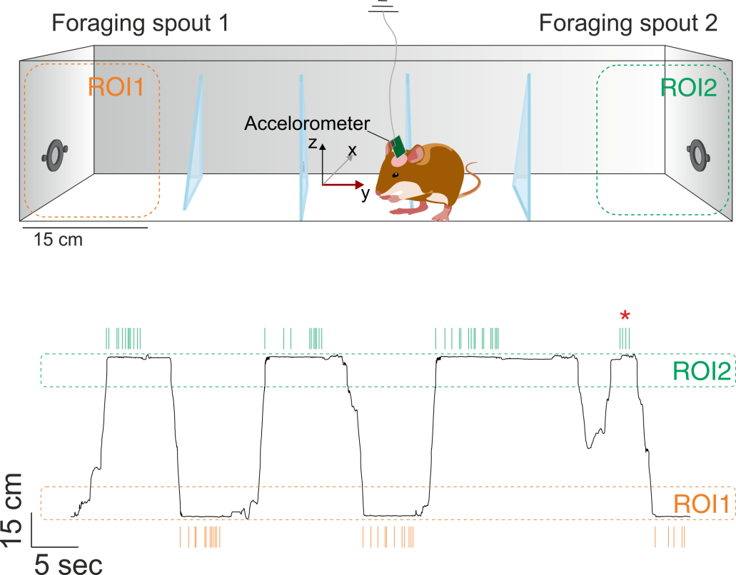


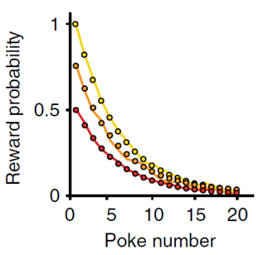
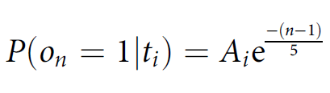
C02 – Happel/Pollmann
ANIMAL FORAGING TASK
PROBABILISTIC FORAGING TASK
Each food restricted animal was trained for 25 days (sessions) continuously in the foraging paradigm without any breaks
Prof. Dr. Frank Ohl (A06)
Lottem et al., 2018
Funded by the Deutsche Forschungsgemeinschaft (DFG, German Research Foundation) – Project-ID 425899996
Notes:
10

Slide 11


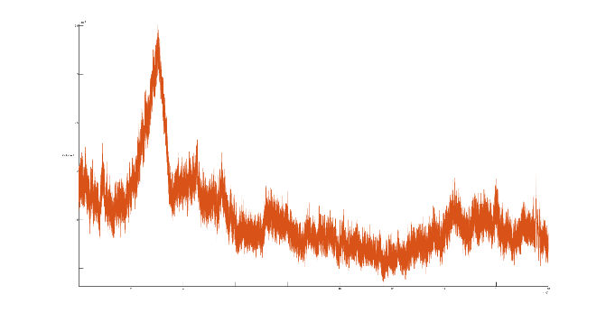
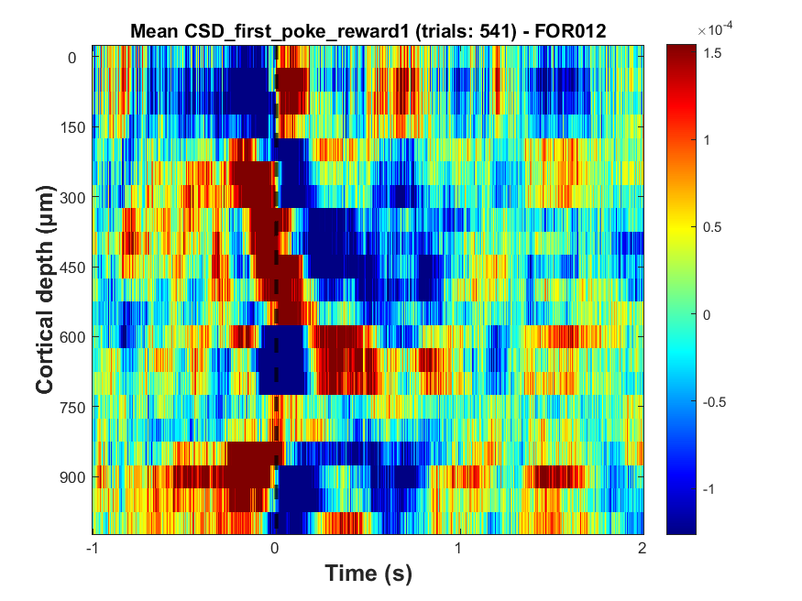
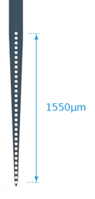
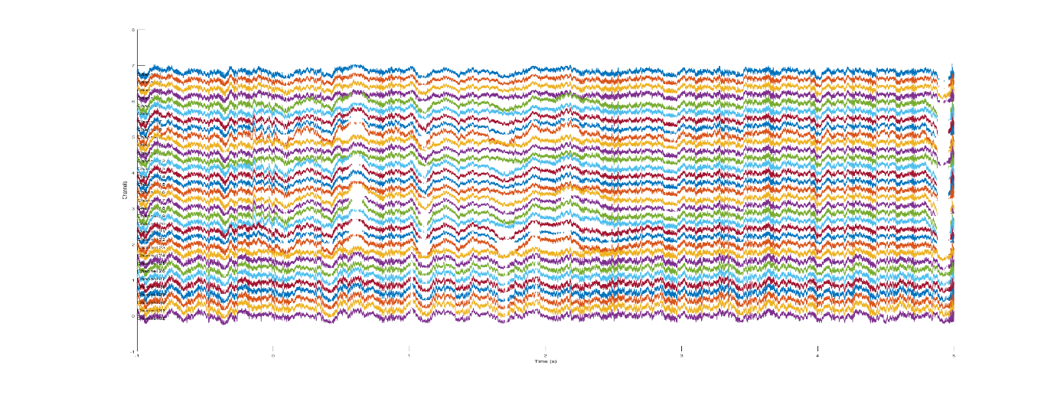
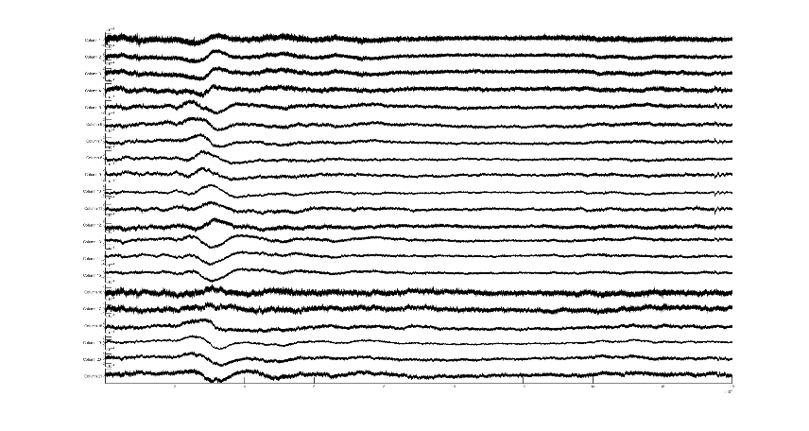
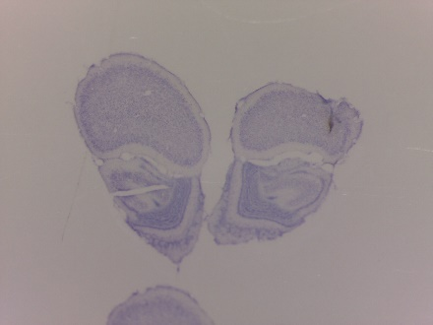
C02 – Happel/Pollmann
ANALYSIS
Second spatial derivative
Vishal Kannan
Layers
I/II/III
Bregma: 4.65mm; ML: 1mm
IV
Va
Vb
VI
Local field potentials
(LFPs)
sink
source
AVREC
Nissl Staining
Current Source Density
(CSD)
Budinger et al., 2016; Zempeltzi et al., 2020
Funded by the Deutsche Forschungsgemeinschaft (DFG, German Research Foundation) – Project-ID 425899996
Notes:
11

Slide 12
C02 – Happel/Pollmann
ANALYSIS
FORAGING BEHAVIOR
Unrewarded
Last poke
Pokes
Last rewarded poke
Unrewarded
Trials with p = 1.0
Trials with p = 0.75
Trials with p = 0.5
Rewarded
Trials
Note: Colored ones are rewarded
First poke
Unrewarded
Lottem et al., 2018
Funded by the Deutsche Forschungsgemeinschaft (DFG, German Research Foundation) – Project-ID 425899996
Notes:
12

Slide 13
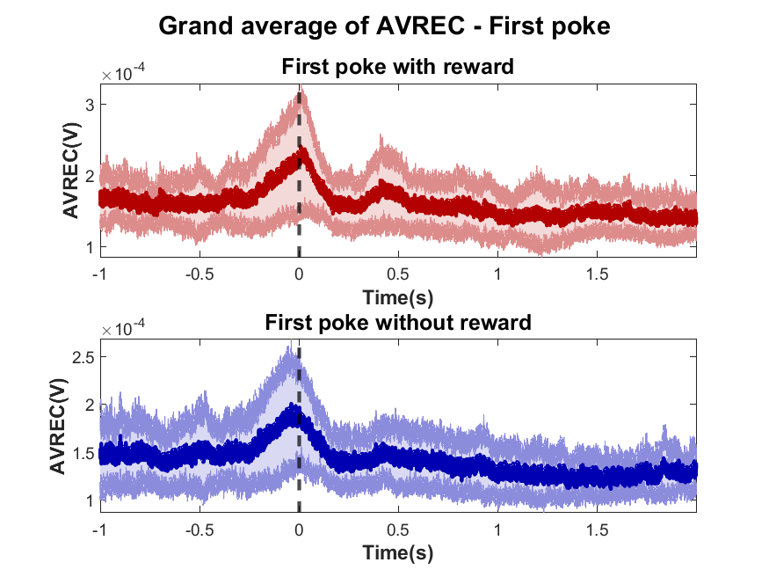
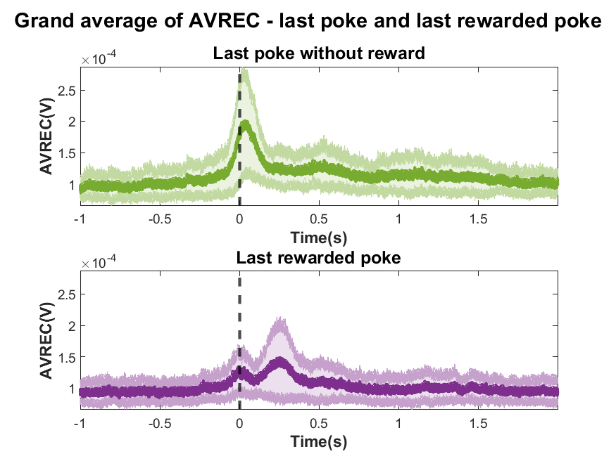
C02 – Happel/Pollmann
RESULTS
GRAND AVREC (N=5)
0th Time point: Start of the poke
0th Time point: End of the poke
Funded by the Deutsche Forschungsgemeinschaft (DFG, German Research Foundation) – Project-ID 425899996
Notes:
13

Slide 14
C02 – Happel/Pollmann
CONCLUSION
HUMAN FORAGING TASK
GERBIL FORAGING TASK
FPC, IPS, and TPJ activity during exploration.
More exploration: Stronger BOLD signals
Elderly people: Decline in exploration
Stable behavior and LFP recordings
Histology: Layers
Decision related CSD: recruitment of cortical circuits
COMPARISON BETWEEN SPECIES
Similarities: how they time their patch-leaving decisions
Funded by the Deutsche Forschungsgemeinschaft (DFG, German Research Foundation) – Project-ID 425899996
Notes:
WP 1.2 FPC, IPS, and TPJ activity was modulated by interindividual differences in a behavioral bias towards exploration. Subjects who tended to explore more readily showed stronger BOLD signal changes.
WP 1.3 Strong evidence for a decline in behavioral exploration in elderly compared to young adults
NEXT Stable foraging behavior of animals after they have learnt the task well gives a sufficient number of trials for further data analysis.
Electrophysiological recordings from frontal cortex revealed proper cortical activity without obvious chewing or movement artefacts.
Histology backed up our layer assignments.
Decision-related CSD analysis showed first hints of differential recruitment of cortical circuits in dependence of rewarded and unrewarded pokes.
NEXT WP 1.1/2.1 Gerbils and humans show similarities in how they time their patch-leaving decisions.
14

Slide 15
C02 – Happel/Pollmann
NEXT STEPS
HUMAN FORAGING TASK
GERBIL FORAGING TASK
Moving to the 7T scanner: Micro-circuits within FP1
Interindividual differences: foraging strategies and FPC activity
Training more animals
Both exploration and exploitation phases:
Overall RMS analysis (AVREC)
Layer-wise AVREC and RMS
COMPARISON BETWEEN SPECIES
Revision of first common publication in Communications Biology
Funded by the Deutsche Forschungsgemeinschaft (DFG, German Research Foundation) – Project-ID 425899996
Notes:
Further investigate the relationship between interindividual differences in their foraging strategies and FPC activity.
15

Slide 16
C02 – Happel/Pollmann
2ND FUNDING PERIOD
Potential topics for the second funding period:
Contribution of human medial temporal lobe to visual exploratory behavior:
Interaction with PFC, parietal cortex and high-level visual cortex (FFA/PPA)
i) two-way interaction between eye movements and memory, mediated by MTL
ii) visual fixations as basic building blocks of memory
Age-related changes / changes in neurodegenerative diseases
i) efficiency of fixation patterns tied to
a) MTL activation changes?
b) connectivity?
Focus on eye movement sequences rather than individual saccades
i) simultaneous eye movement and fMRI measurement
ii) classification with machine learning algorithms
Funded by the Deutsche Forschungsgemeinschaft (DFG, German Research Foundation) – Project-ID 425899996
Notes:
16

Slide 17
C02 – Happel/Pollmann
PUBLICATIONS
Güldener, L., Jüllig, A., Soto, D., & Pollmann, S. (2022). Frontopolar activity carries feature information of novel stimuli during unconscious reweighting of selective attention. Cortex, 153, 146-165, https://doi.org/10.1016/j.cortex.2022.03.024.
Pollmann; S., & Schneider, W.X. (2022). Working memory and active sampling of the environment: medial temporal contributions. in: Miceli, G., Bartolomeo, P. & Navarro, V. Handbook of Clinical Neurology: The Temporal Lobes. Amsterdam, Elsevier, 187:339-357. doi: 10.1016/B978-0-12-823493-8.00029-8.
Güldener, L., Saravanakumar, P., Happel, M.F.K., Ohl, F.W., Vollmer, M., & Pollmann, S. When is it time to move on? Patch-leaving behavior during probabilistic foraging in humans and gerbils. (in revision)
Güldener, L., & Pollmann, S. The neural substrates of exploratory foraging choices during visual search. (in preparation)
THANK YOU!!! QUESTIONS???
Funded by the Deutsche Forschungsgemeinschaft (DFG, German Research Foundation) – Project-ID 425899996
Notes:
17

Slide 18
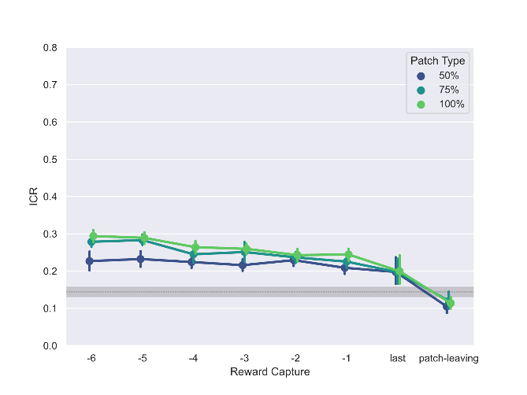
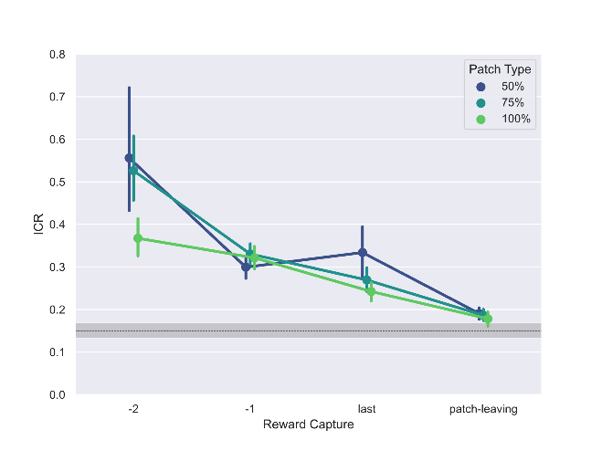
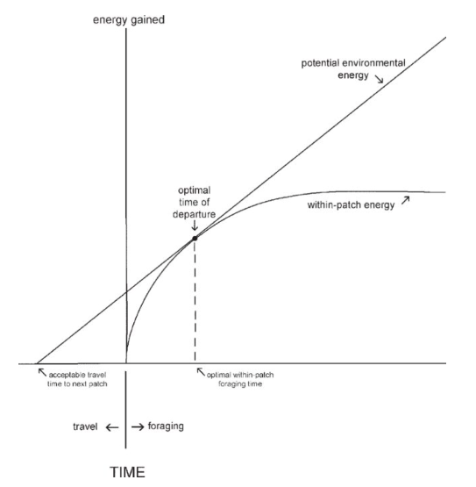
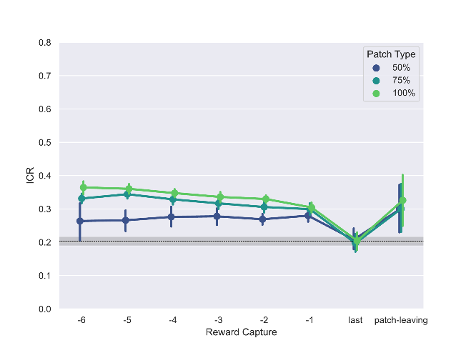
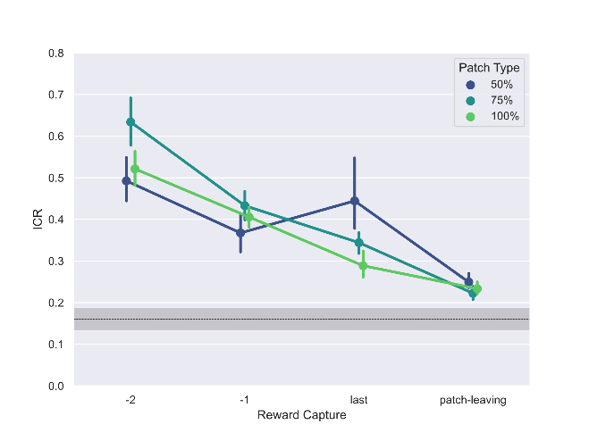
C02 – Happel/Pollmann
APPENDIX
Mechanisms humans‘ and gerbils‘ patch-leaving decisions obey to:
3) Marginal value theorem:
Humans long GUT
Gerbils long GUT
Humans short GUT
Gerbils short GUT
Funded by the Deutsche Forschungsgemeinschaft (DFG, German Research Foundation) – Project-ID 425899996
Notes:
According to the MVT the optimal time for patch-leaving should be timed to the moment when the current energy intake rate (for example measured as reward captures per second which I will refered to as the collection rate ) in the current patch approximates the average reward rate of the entire environment NEXT Both gerbil groups showed an approximation of their collection rates towards the averge harvest rate. But, Humans with above median GUTs tended to stay longer than what‘s considered optimal by theory, while humans with below median GUTs set the duration of their GUTs in such a way that the estimated ICR at the time of leaving (which is the inverse of the GUT) was again somwhat above the average rate. Thus, support for a deviation from the MVT we found for humans with above median GUTs displaying a bias towards exploitation. This difference between long and short GUT individuals was absent in the Gerbils.
18

Slide 19
C02 – Happel/Pollmann
APPENDIX
FrA Region
Bregma:
5mm
Funded by the Deutsche Forschungsgemeinschaft (DFG, German Research Foundation) – Project-ID 425899996

Slide 20
C02 – Happel/Pollmann
APPENDIX
Control animals
Bregma:
4mm
Funded by the Deutsche Forschungsgemeinschaft (DFG, German Research Foundation) – Project-ID 425899996

Slide 21
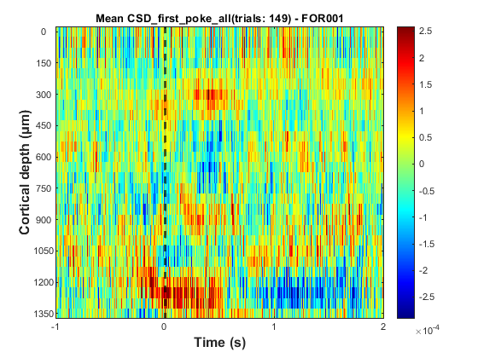
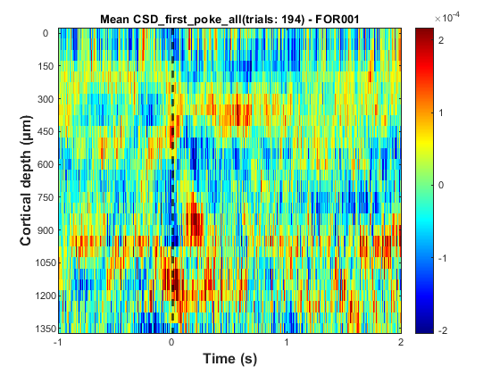
C02 – Happel/Pollmann
APPENDIX
DIFFERENCE BETWEEN PHASES OF FORAGING
Layers
I/II/III
IV
Va
Vb
VI
Learning phase
(Ses: 1 to 5)
Learned phase
(Ses: 6 to 10)
Funded by the Deutsche Forschungsgemeinschaft (DFG, German Research Foundation) – Project-ID 425899996
Notes:
21

Slide 22
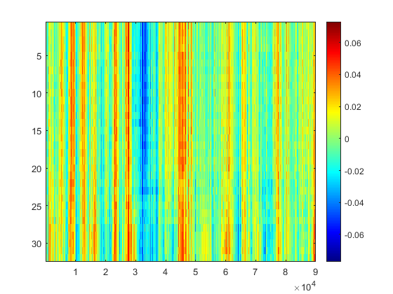
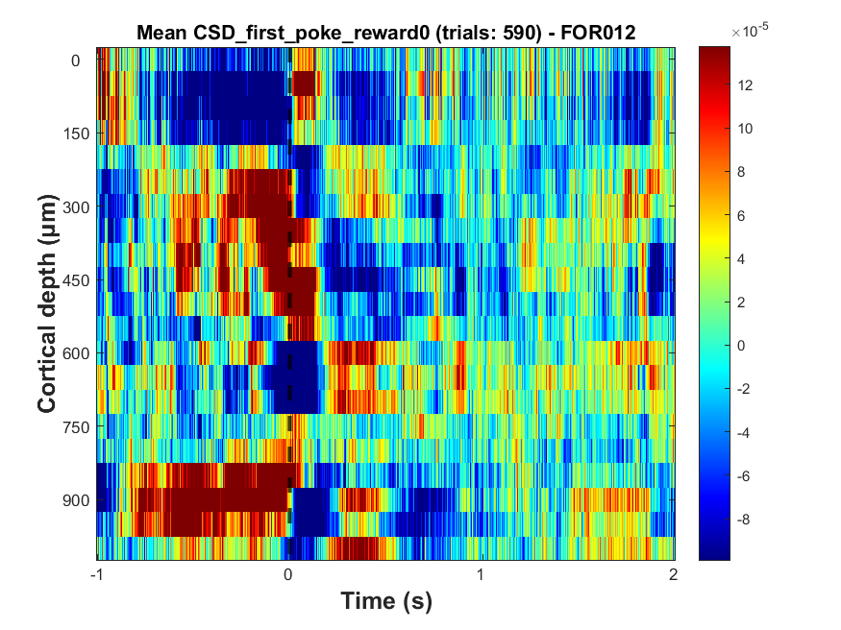
C02 – Happel/Pollmann
APPENDIX
DIFFERENCE BETWEEN LFP AND CSD
LFP
CSD
Funded by the Deutsche Forschungsgemeinschaft (DFG, German Research Foundation) – Project-ID 425899996
Notes:
22

Slide 23
C02 – Happel/Pollmann
CSD
Layers
I/II/III
IV
Va
Vb
VI
Rewarded
Unrewarded
0th Time point:
Start of the poke
POKE RELATED CSD (FIRST POKE) - ONE ANIMAL
Funded by the Deutsche Forschungsgemeinschaft (DFG, German Research Foundation) – Project-ID 425899996

Slide 24
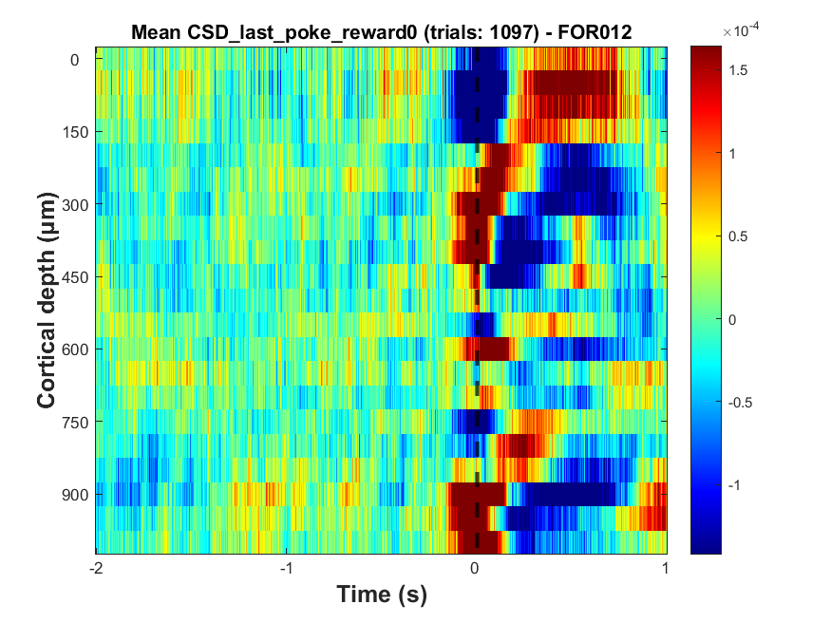
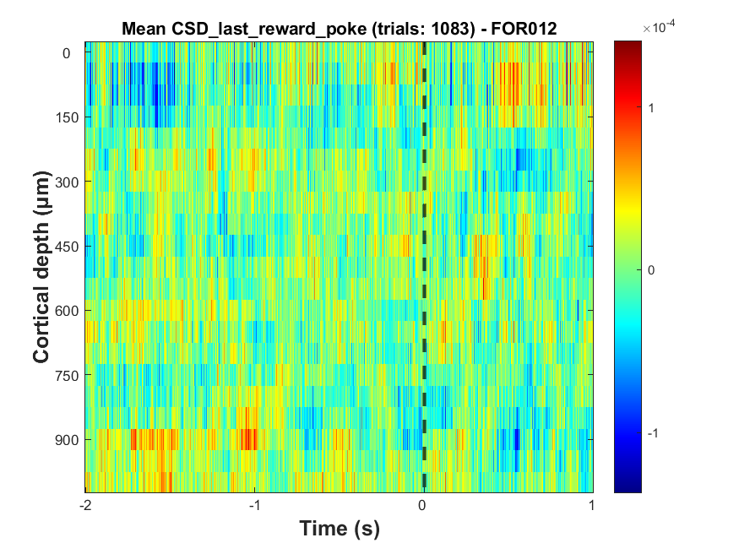
C02 – Happel/Pollmann
CSD
Layers
I/II/III
IV
Va
Vb
VI
Last poke unrewarded
Last rewarded poke
0th Time point:
End of the poke
POKE RELATED CSD - ONE ANIMAL
Funded by the Deutsche Forschungsgemeinschaft (DFG, German Research Foundation) – Project-ID 425899996

Slide 25
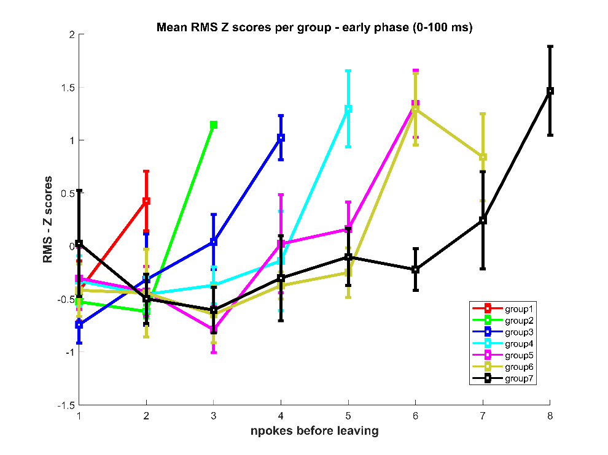
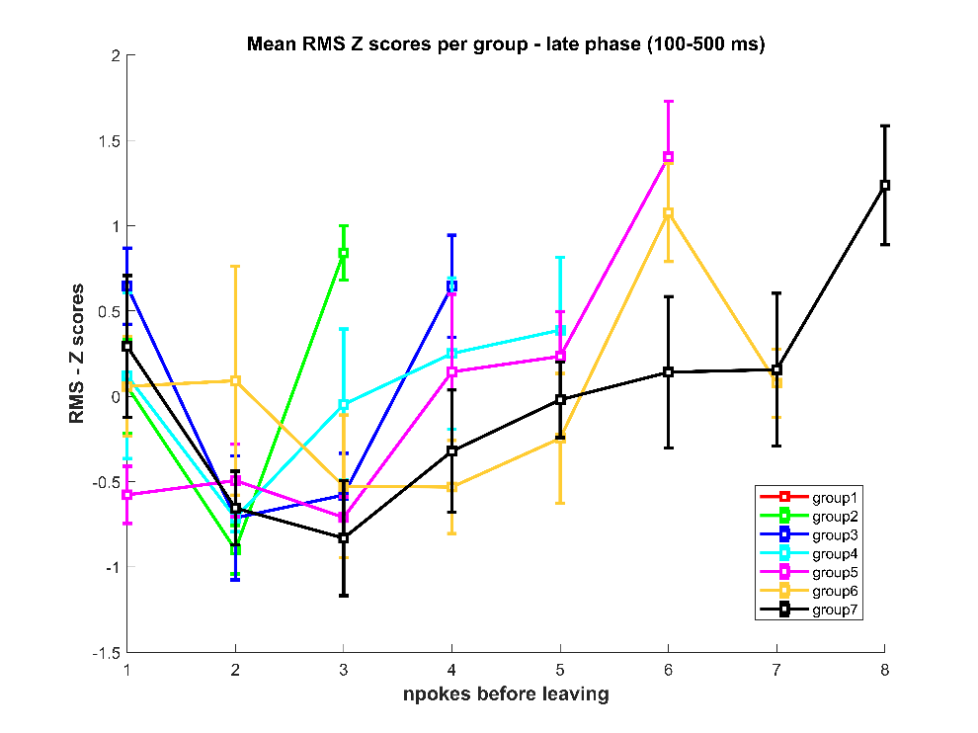
C02 – Happel/Pollmann
RMS
Funded by the Deutsche Forschungsgemeinschaft (DFG, German Research Foundation) – Project-ID 425899996

Slide 26
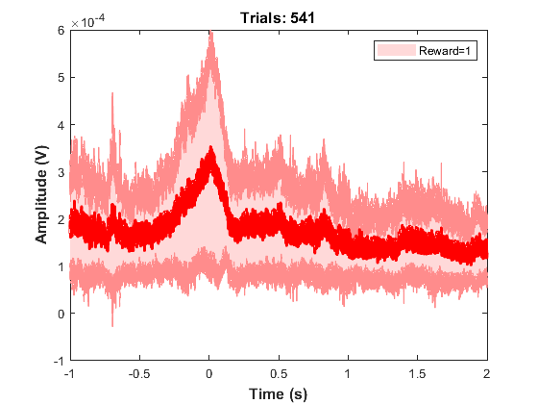
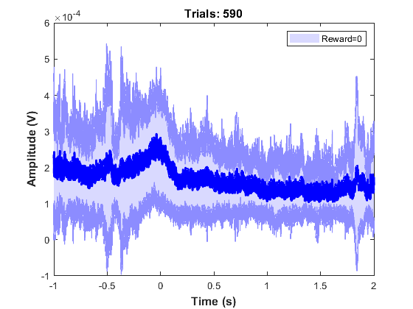
C02 – Happel/Pollmann
AVREC
Rewarded
Unrewarded
FIRST POKE - ONE ANIMAL
Funded by the Deutsche Forschungsgemeinschaft (DFG, German Research Foundation) – Project-ID 425899996

Slide 27
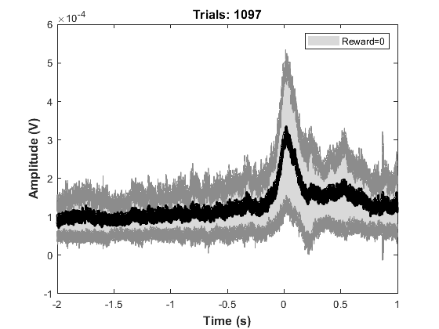
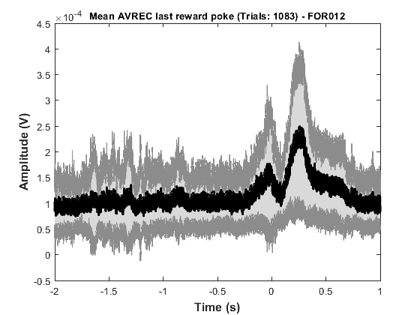
C02 – Happel/Pollmann
AVREC
Last poke unrewarded
Last rewarded poke
LAST POKE - ONE ANIMAL
Funded by the Deutsche Forschungsgemeinschaft (DFG, German Research Foundation) – Project-ID 425899996

Slide 28


C02 – Happel/Pollmann
APPENDIX
AVREC: FIRST POKE
Rewarded
Unrewarded
Funded by the Deutsche Forschungsgemeinschaft (DFG, German Research Foundation) – Project-ID 425899996
Notes:
28

Slide 29


C02 – Happel/Pollmann
APPENDIX
AVREC: LAST POKE
Rewarded
Unrewarded
Funded by the Deutsche Forschungsgemeinschaft (DFG, German Research Foundation) – Project-ID 425899996
Notes:
29

Slide 30

C02 – Happel/Pollmann
APPENDIX
AVREC: LAST REWARDED POKE
Funded by the Deutsche Forschungsgemeinschaft (DFG, German Research Foundation) – Project-ID 425899996
Notes:
30

Slide 31

C02 – Happel/Pollmann
APPENDIX
ELECTRODE
Funded by the Deutsche Forschungsgemeinschaft (DFG, German Research Foundation) – Project-ID 425899996

